Slide 1

Data Transformation II

Slide 2
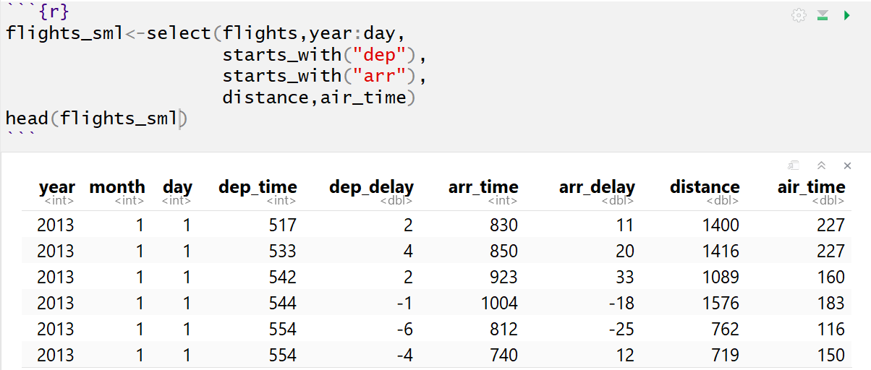
mutate()
Used to Create New Variables
Creative New Metrics
Modify Units
Transform Variables
Unique Identifiers
Numeric to Categorical
Categorical to Numeric
Reduced Dataset

Slide 3
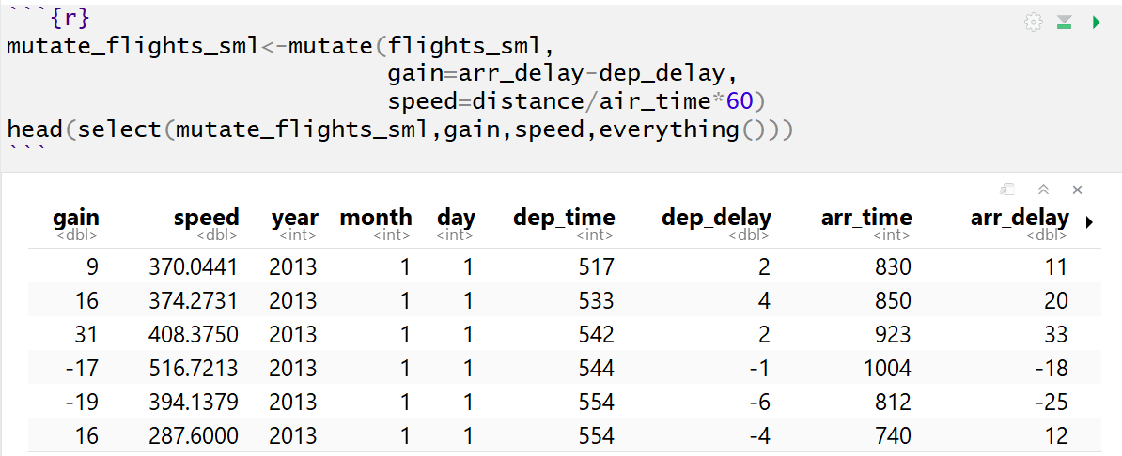
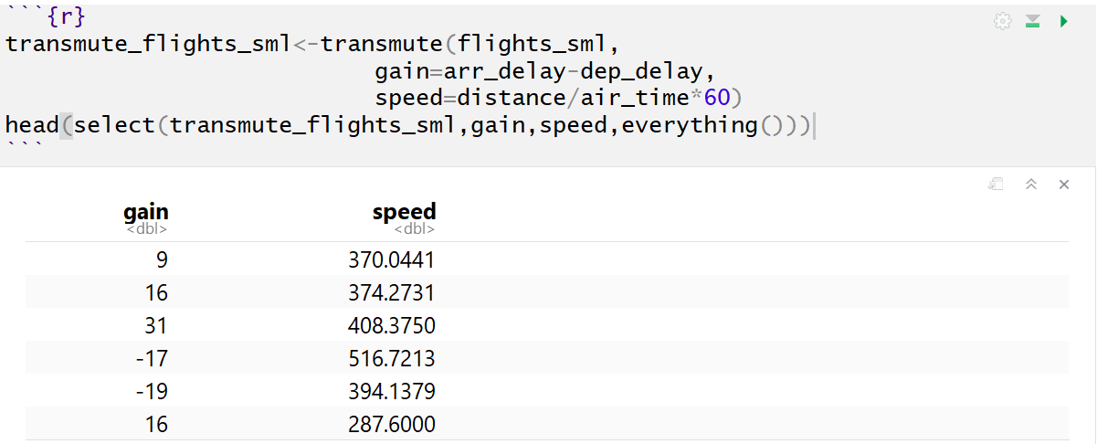
mutate()
Example of mutate()
Example of transmute()

Slide 4
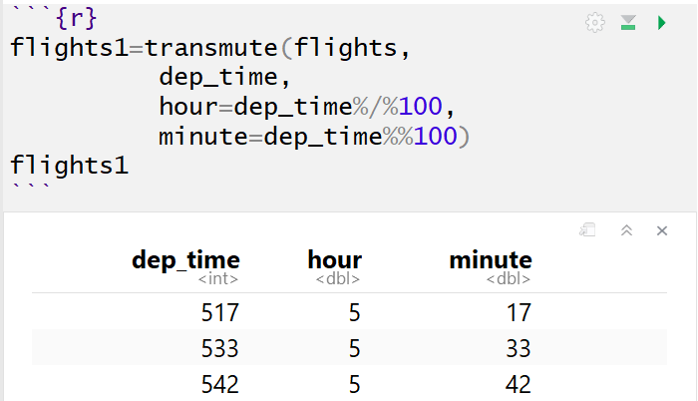
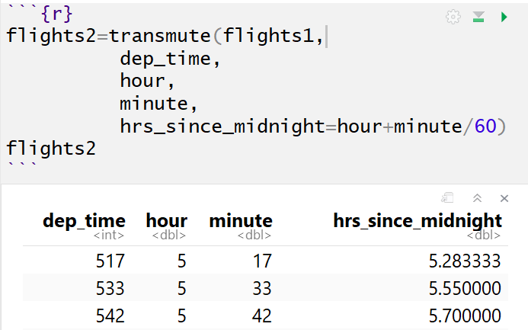

mutate()
Plethora of Examples
Basic and Modular Arithmetic
$517=100∗5+17$
$=100∗\left(517 \%/\% 100\right)+(517 \%\% 100)$

Slide 5
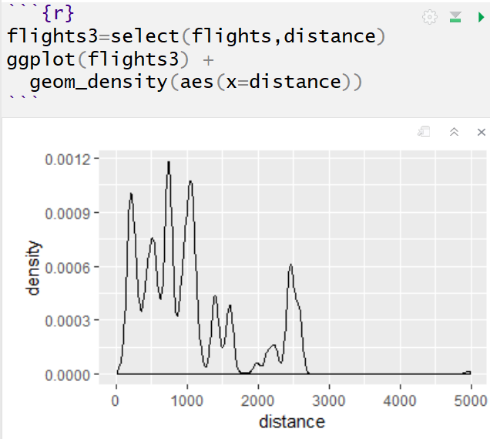
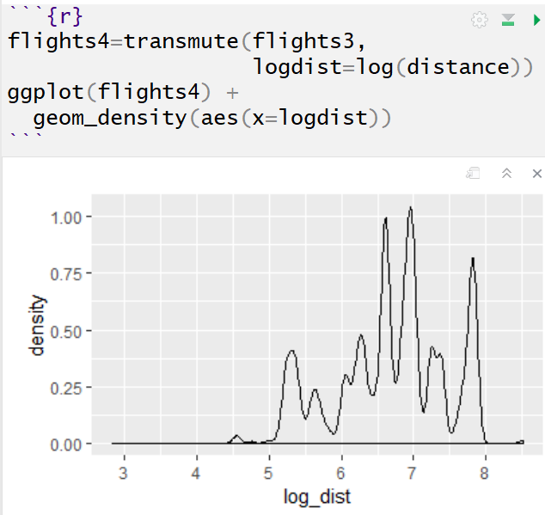
mutate()
Plethora of Examples
Nonlinear Transformation

Slide 6
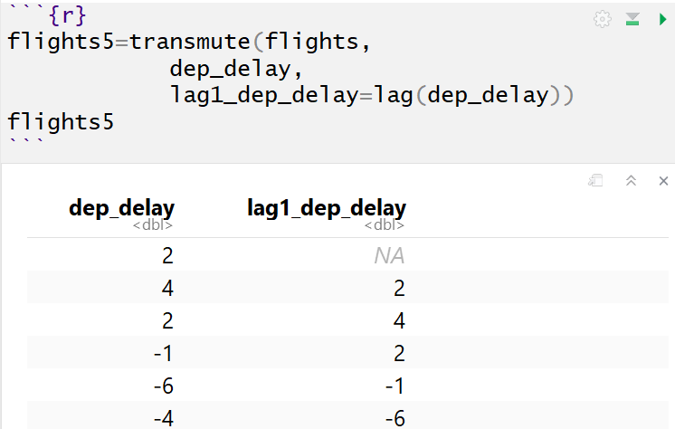
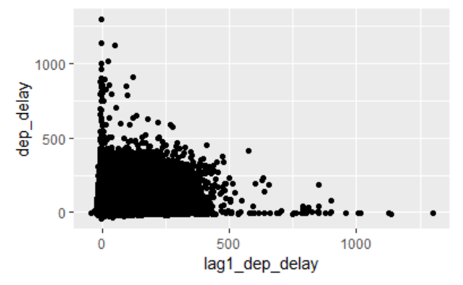
mutate()
Plethora of Examples
Offsets

Slide 7
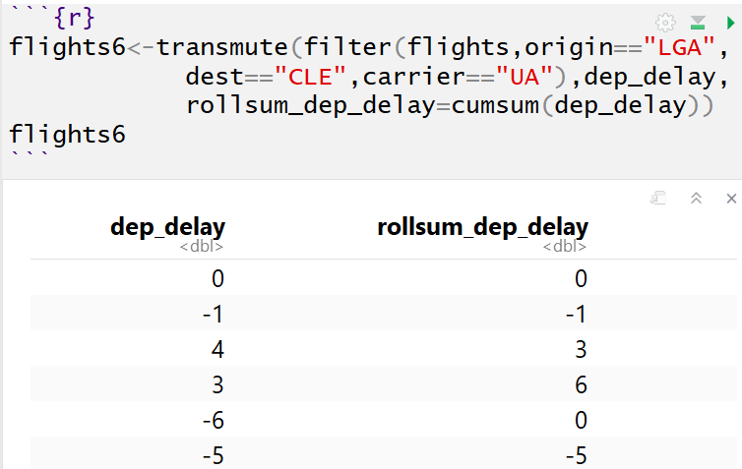
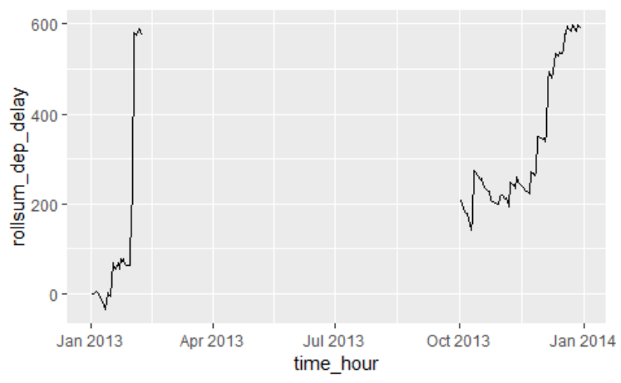
mutate()
Plethora of Examples
Cumulative and Rolling Aggregates

Slide 8
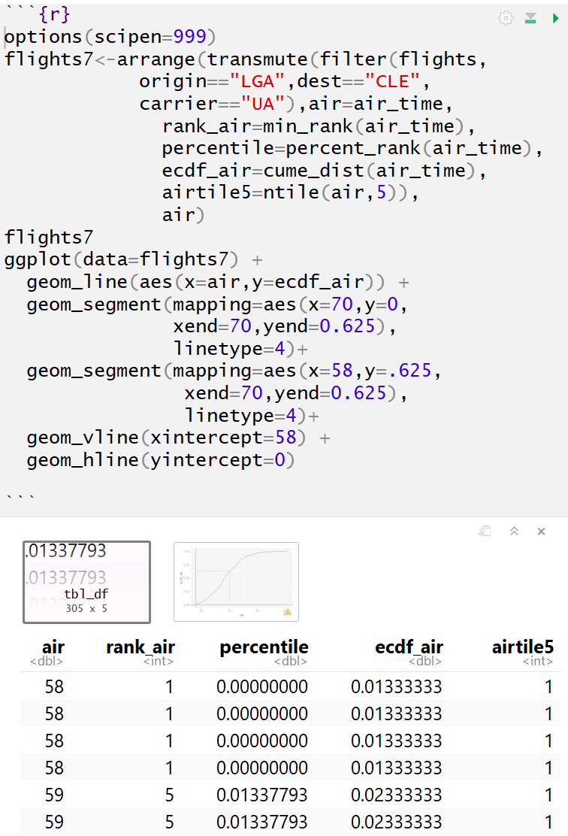
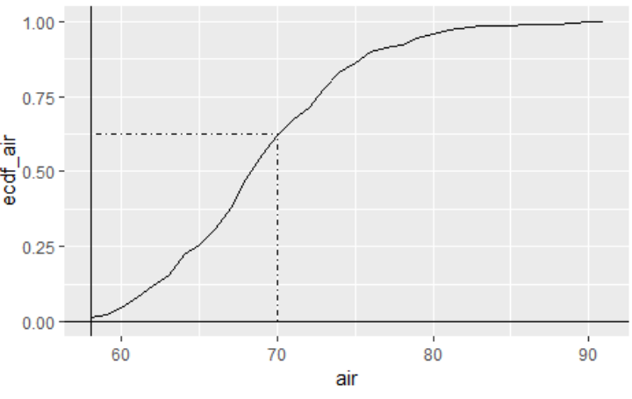
mutate()
Plethora of Examples
Ranking

Slide 9
Information
Tutorial 3
Practice
filter()
arrange()
select()
mutate()
Introduced
Piping %>%
group_by()
summarize()
Chain of Command
Google -> Friend -> Instructor

Slide 10
Closing
Disperse and Make Reasonable Decisions

